Slide 1
Advancing Tools and Processes for Next Generation Science Planning for Instruction
Tool 2 Lite: Using Performance Expectations
to Plan Classroom Assessments

Slide 2
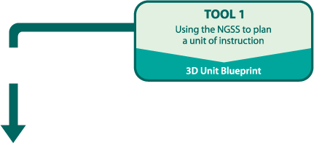
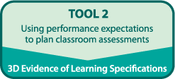
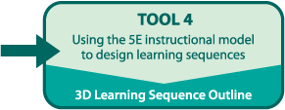
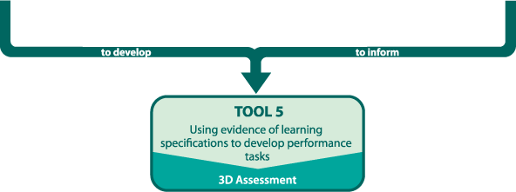
Planning for Instruction
LITE!

Slide 3
Goal
Analyze evidence statements to consider how SEPs, DCIs, and CCCs impact classroom instruction

Slide 4
Planning for classroom instruction
What do you need to consider when planning for classroom instruction?

Slide 5
Classroom Assessment Design

Slide 6
Evidence Statements
Read the NGSS Evidence Statements Executive Summary.
Be prepared to share key ideas with a partner.

Slide 7
Evidence Statements
Review the example handout for MS-LS2-2.
What do you notice?
Review the handout for ESS3-4
Use Tool 1 to help you highlight and cross-out text in the PE and in the evidence statements.
Compare your work to the example.
How does this help you think about planning for assessment? For classroom instruction?

Slide 8
Give it a try!
https://nextgenscience.org/evidence-statements
Select the relevant evidence statements for the unit you are planning!

Slide 9
Enter your Evidence Specs on Tool 2

Slide 10
Reflection
How does the work with the evidence statements help you think about the conceptual shifts needed to implement the vision of the NGSS in classroom instruction?

